Slide 1
Polling and Election
Data Analysis
Presented By: Marina, Madhu, Push, & Gabby

Slide 2
Our Question
What states are the most influential in elections?
Historical voting patterns
Present day voting power of individuals in a state
Future projections based on population
Polls Data Analysis
Notes:
Talk about predictors that we were interested in looking at
Describe the questions you and your group found interesting, and what motivated you to answer them
Motivation & Summary Slide
Define the core message or hypothesis of your project.
Describe the questions you asked, and why you asked them
Describe whether you were able to answer these questions to your satisfaction, and briefly summarize your findings

Slide 3
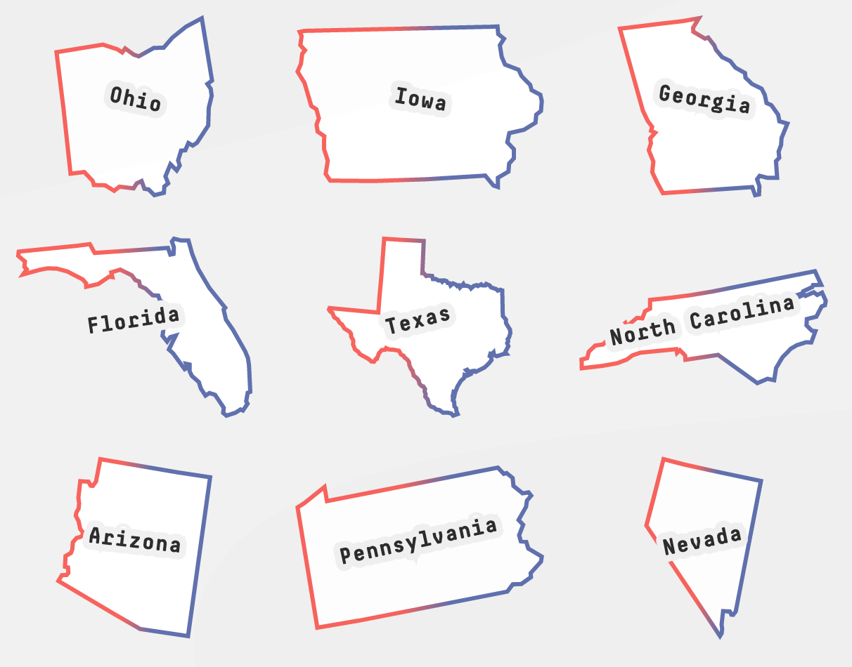
States to Watch in 2020
Ohio
Iowa
Georgia
Florida
Texas
North Carolina
Arizona
Pennsylvania
Nevada
Wisconsin
Source: https://projects.fivethirtyeight.com/2020-election-forecast/?cid=rrpromo
Notes:
Talk about predictors that we were interested in looking at
Describe the questions you and your group found interesting, and what motivated you to answer them
Motivation & Summary Slide
Define the core message or hypothesis of your project.
Describe the questions you asked, and why you asked them
Describe whether you were able to answer these questions to your satisfaction, and briefly summarize your findings

Slide 4
Historical Voting Pattern Analysis
Analysis of patterns of votes by state from 1976 to 2016
Identify swing states and influential states
Sources:
Harvard Elections Data
Archive
The Guardian article
Data Clean Up
Filter by democrats and Republican
Finding the winner by state by year

Slide 5
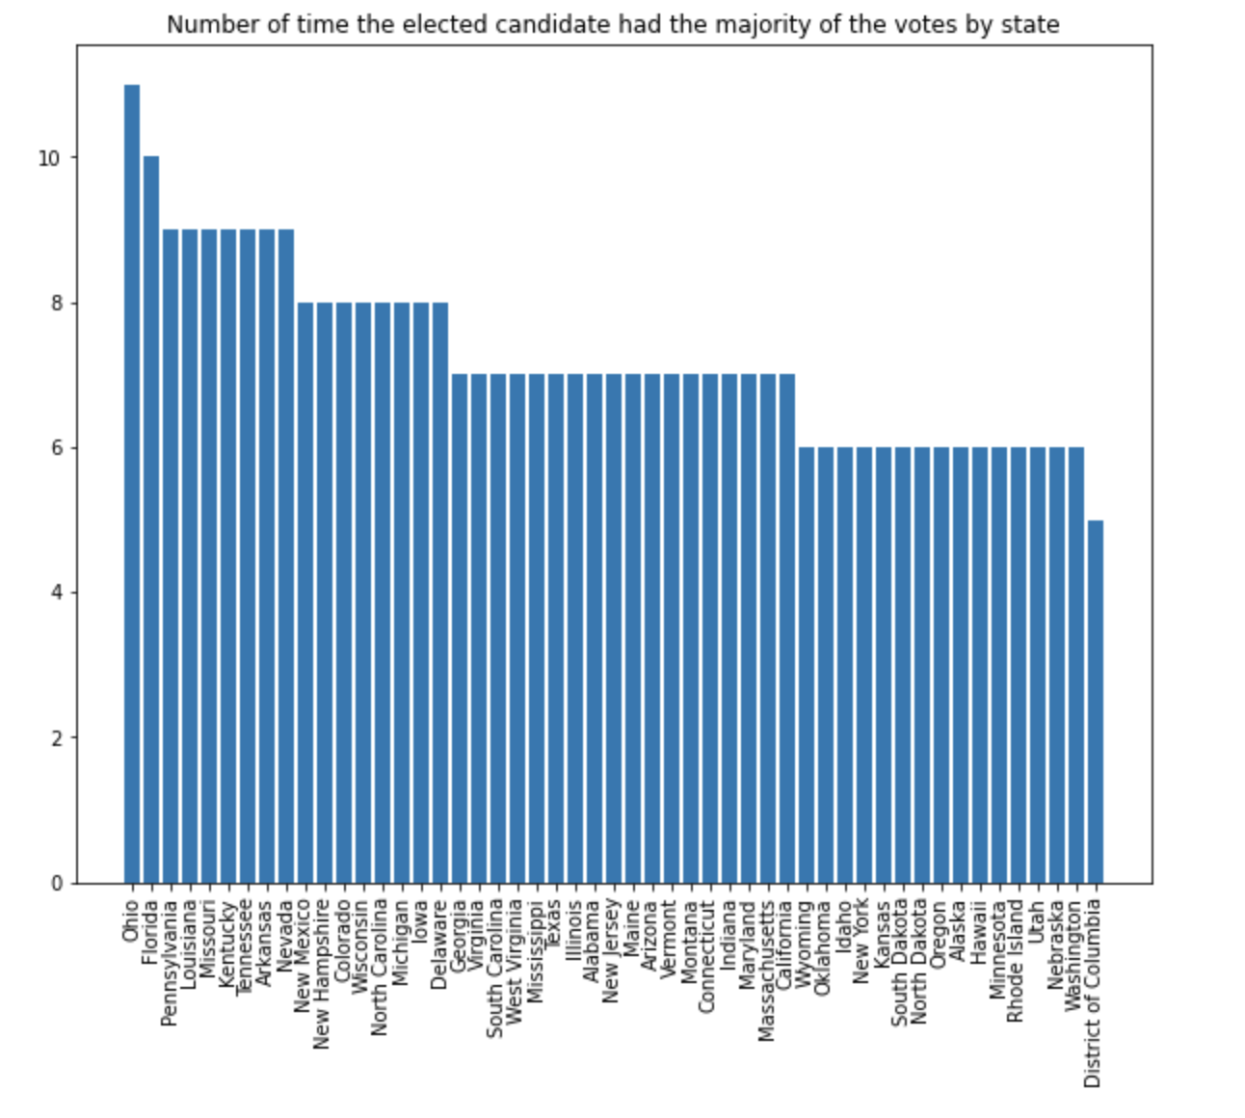
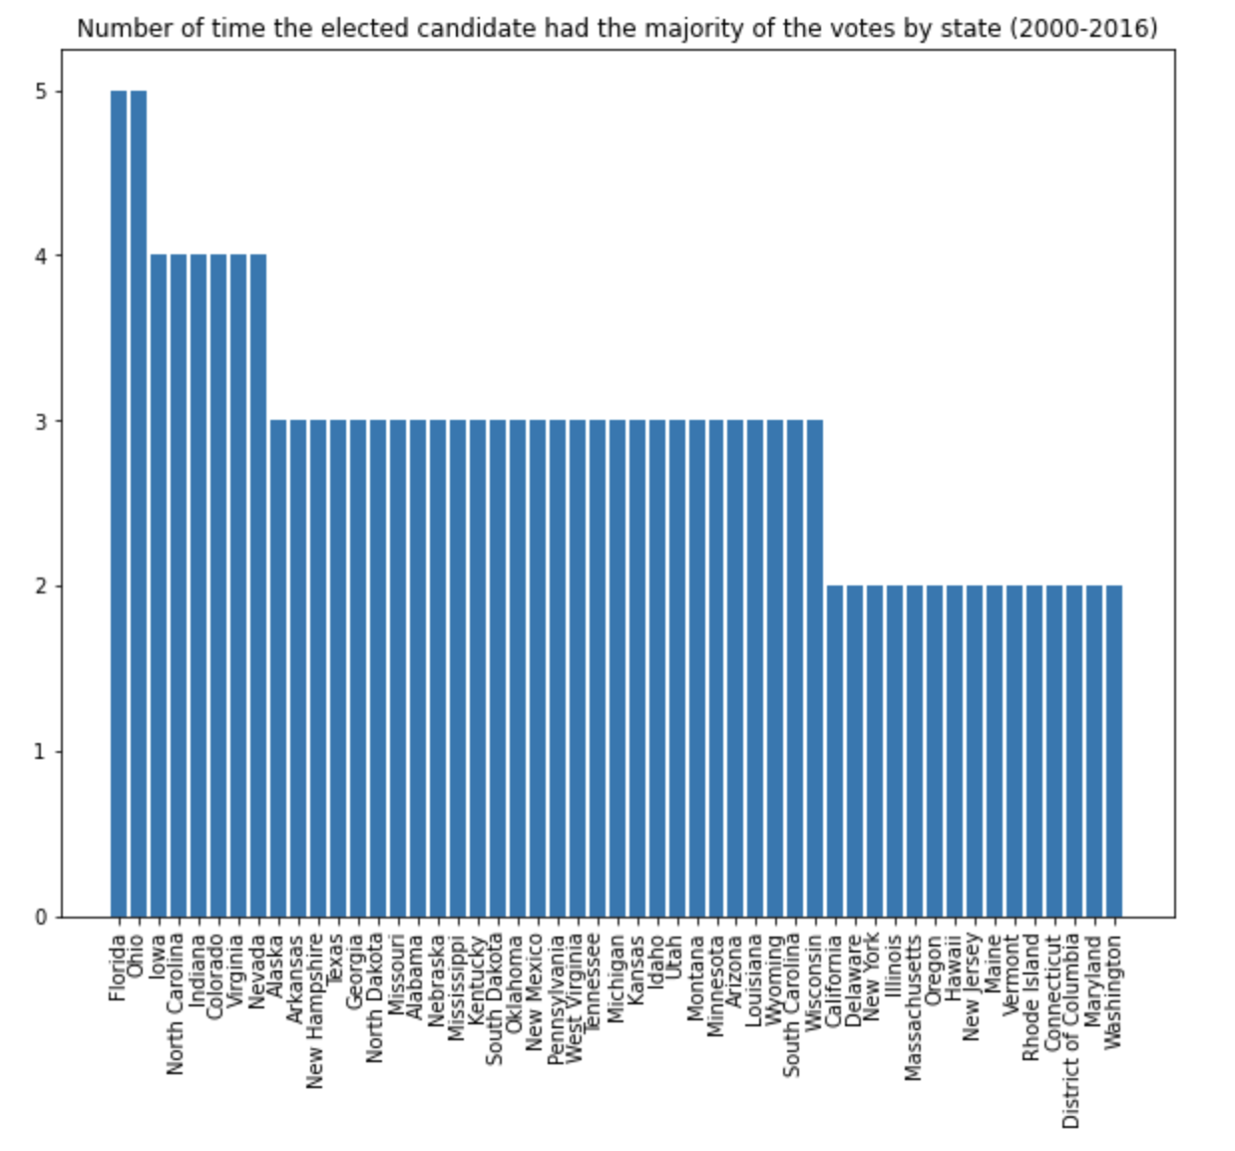
Historical Voting Pattern Analysis
In the past 11 elections the elected candidate had the majority of the votes 11 times in Ohio and 10 in Florida. The second chart is showing the past 5 elections.

Slide 6
Individual Voting Power
Influence on an individual voter basis
Where have votes counted most …
Historically?
2016 Election?
Likely in 2020?
Sources:
Harvard Elections Data Archive
State Latitude & Longitude
Adam Carr’s Election Archive
Data Clean Up
Excel VBA Macro
Voting Power Analysis

Slide 7
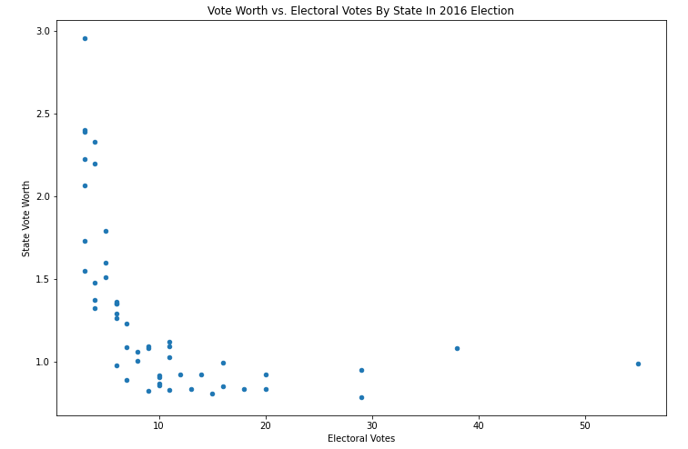
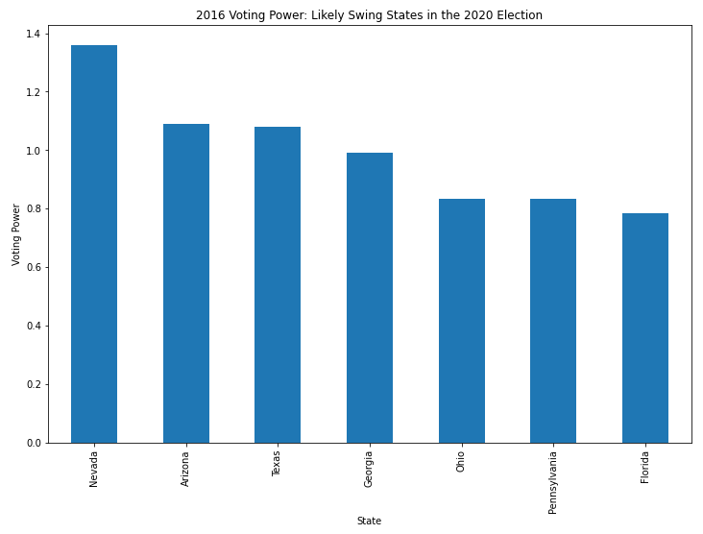
Individual Voting Power
Smaller states higher vote worth but the effects diminish with greater electoral votes. States with a moderate population - swing states - have the right balance to maximize influence.

Slide 8
Future Political Projections
How are states going to vote in the future?
Based on changing racial demographics in a state
Considerations:
How are state demographics projected to change?
Who actually votes?
What are the political preferences of each demographic?
Data Sources and Cleanup
NC Population Projections
2016 Turnout by Demographic
2016 Political Preferences

Slide 9
Future Political Projections
538 Swing States:
Ohio
Iowa
Georgia
Florida
Texas
North Carolina
Arizona
Pennsylvania
Nevada
Wisconsin
From Part 1:
Ohio
Florida
Iowa
North Carolina
Pennsylvania
Nevada
From Part 2:
Nevada
Georgia
Texas
Arizona

Slide 10
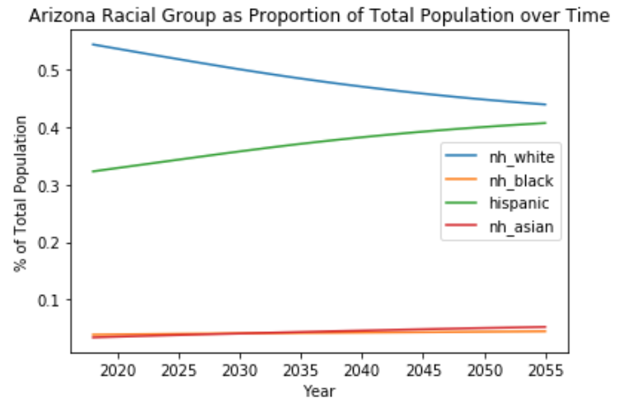
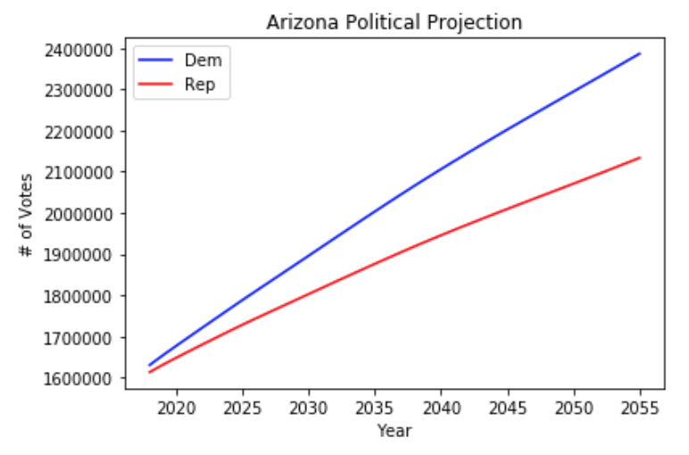
Future Political Projections

Slide 11
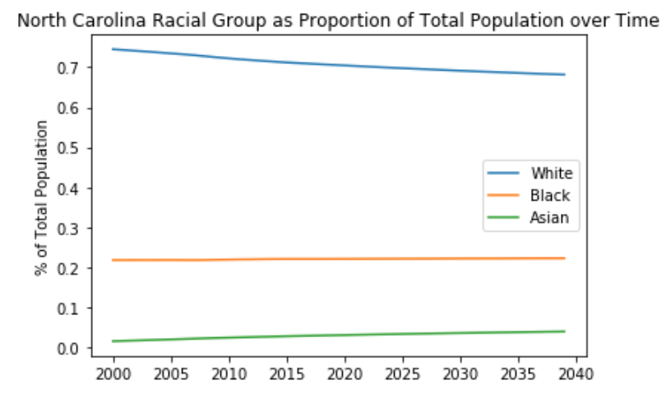
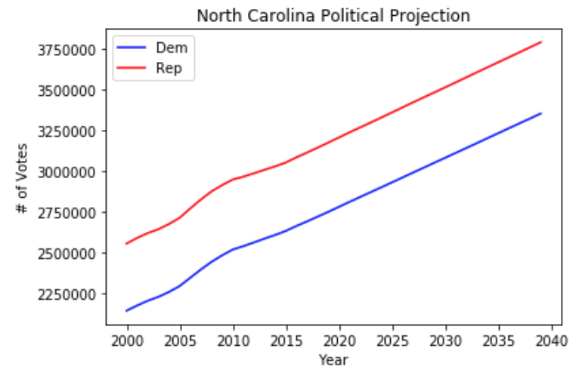
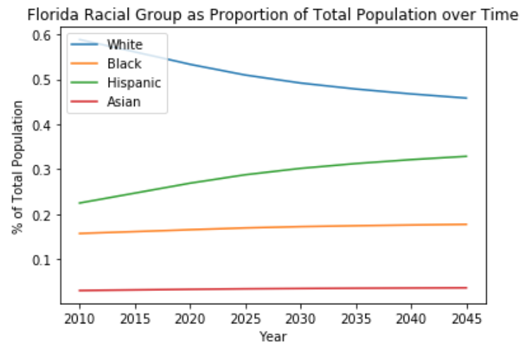
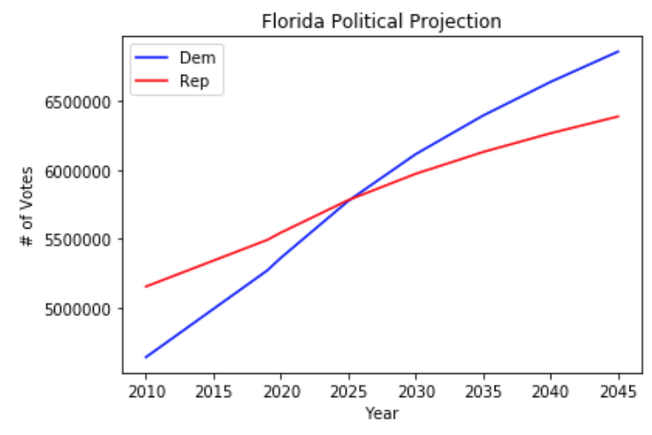

Slide 12
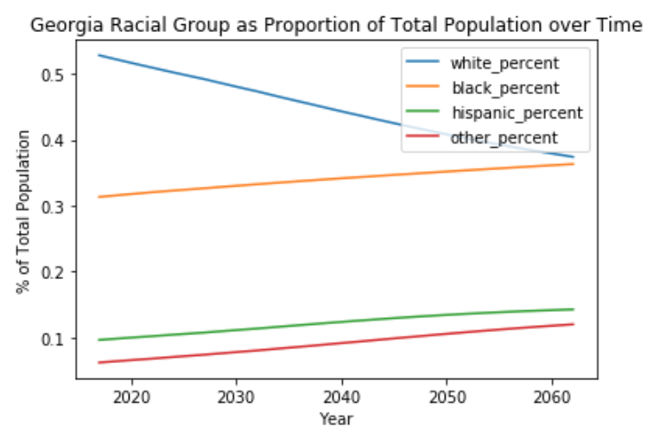
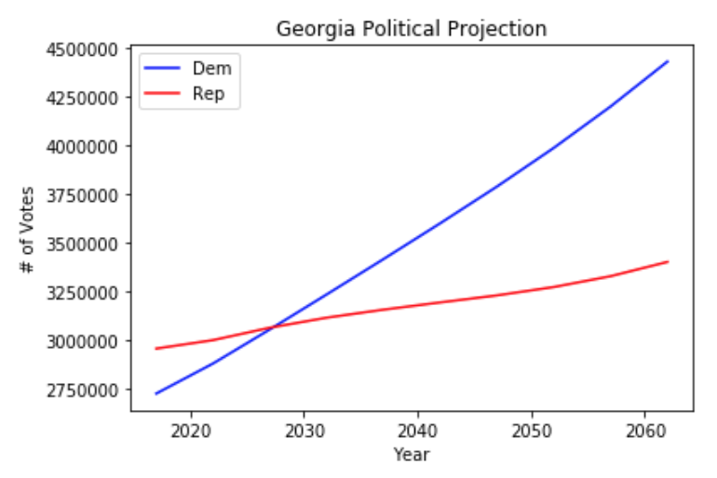
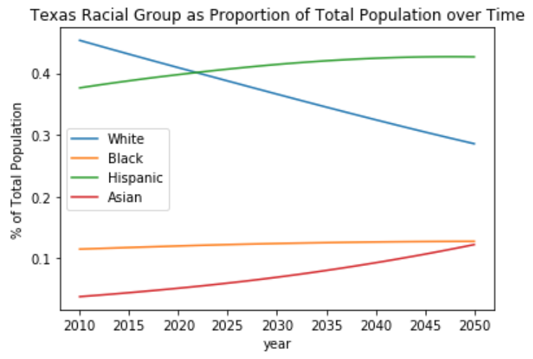
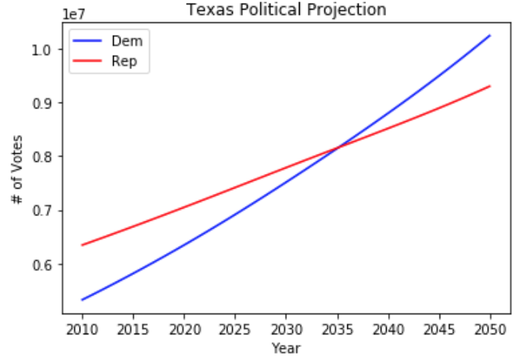

Slide 13
Polls Data Analysis
Analyzing the polls results for 2020 election in the key states after our previous analysis.
Sources:
Fivethirtyeight
Data clean up
Give the date column a date format
Using data only from best rated pollsters

Slide 14
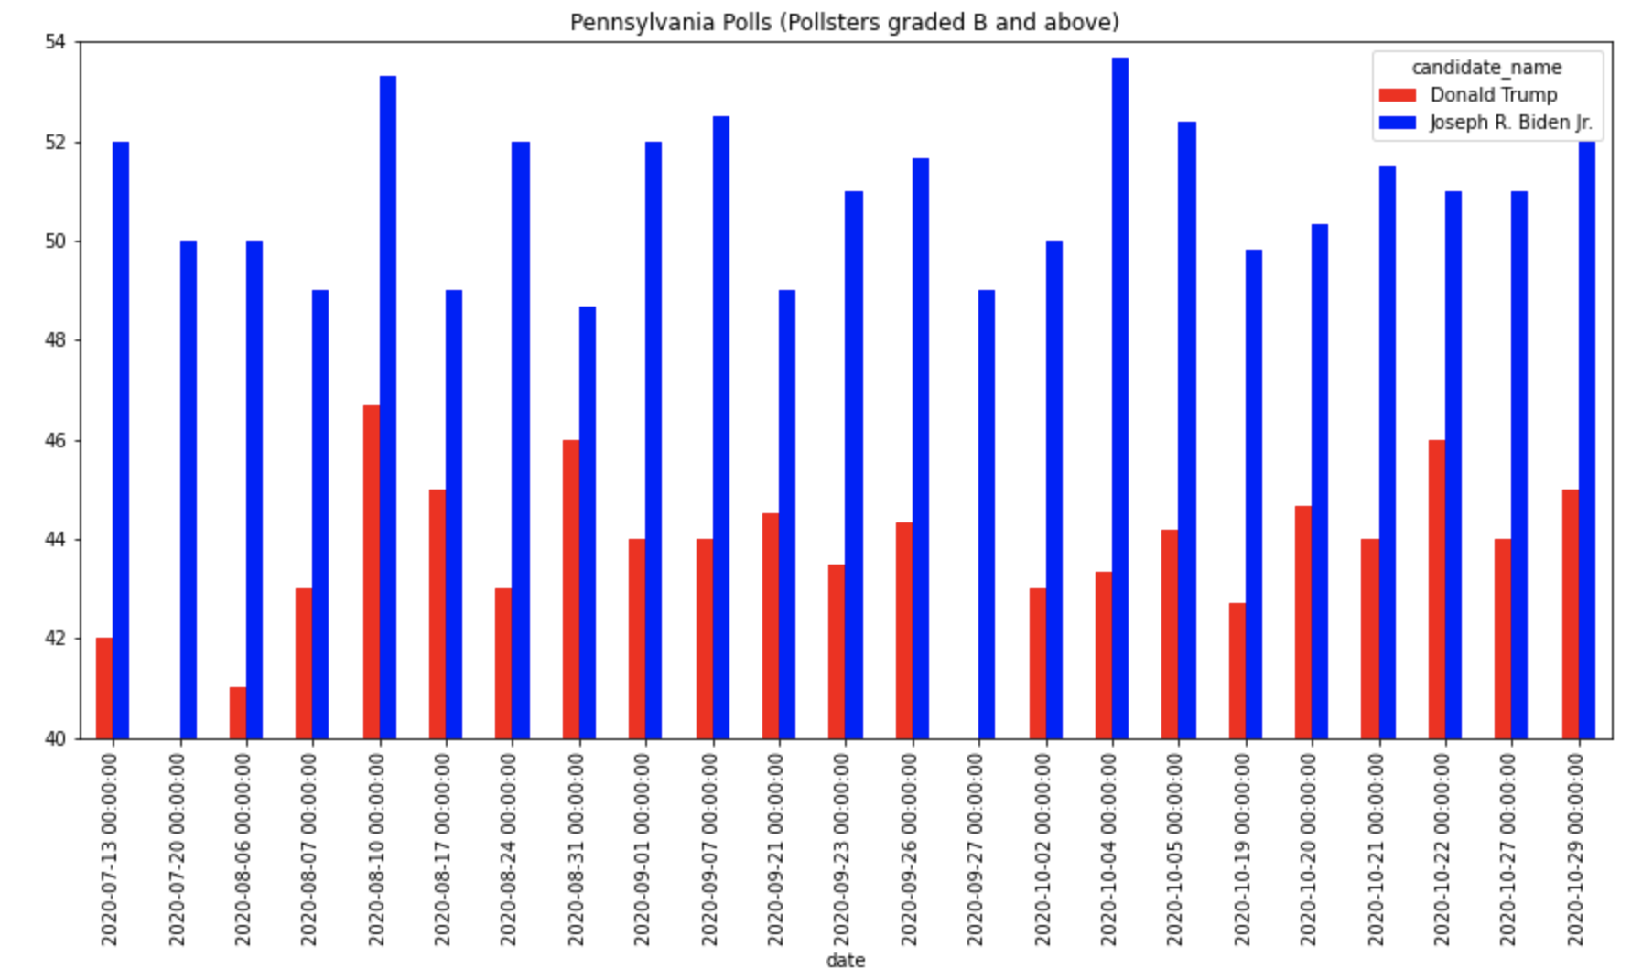
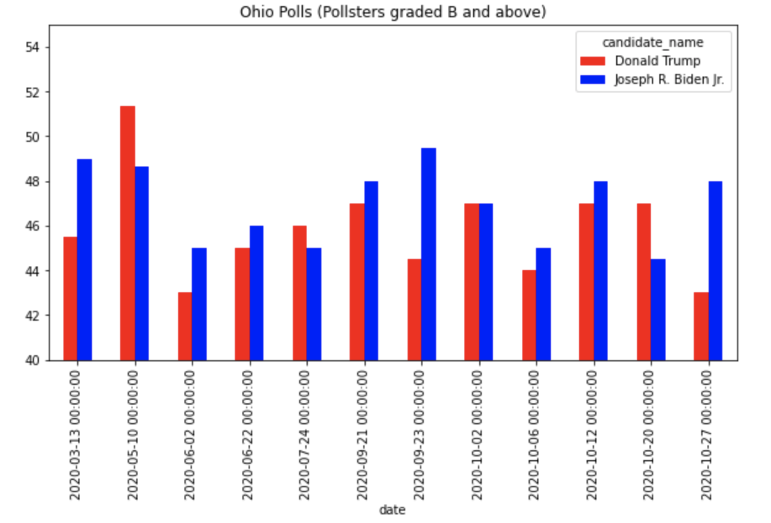
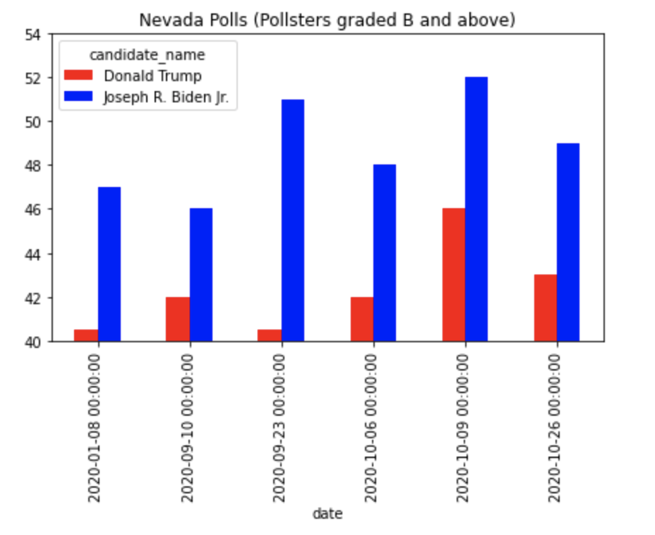
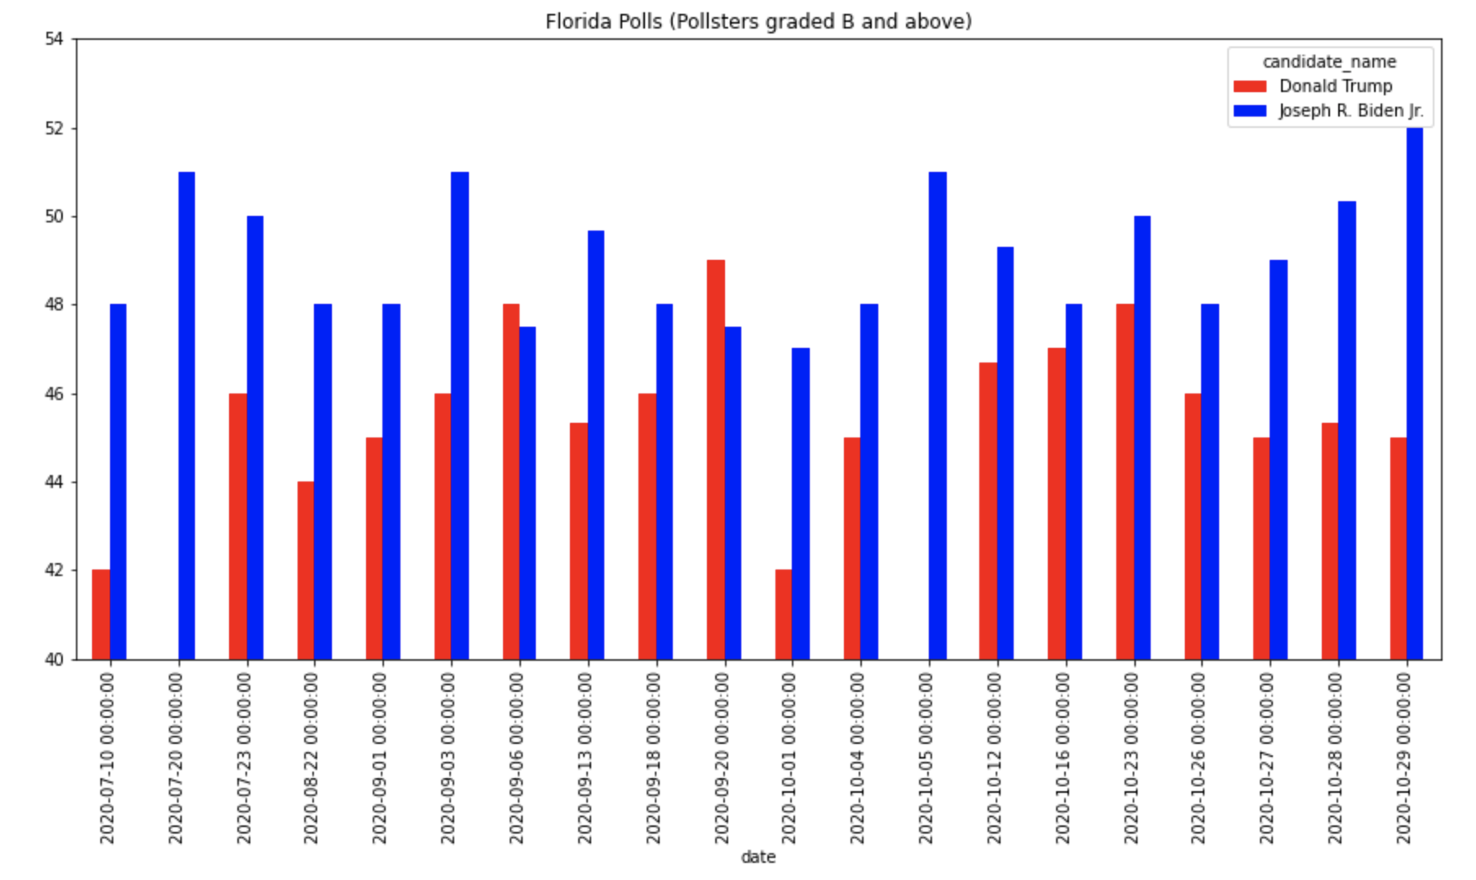
Polls results for key states

Slide 15
Discussion

Slide 16
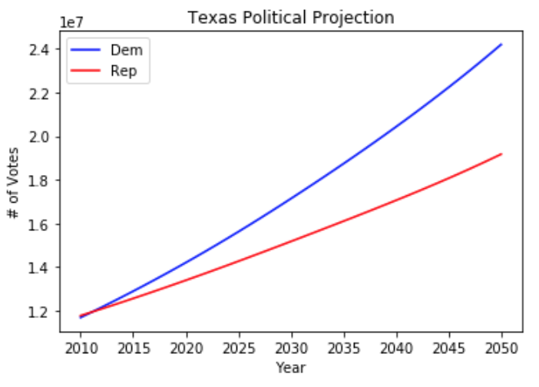
Discussion
State voting patterns change - how a state voted in the past isn’t necessarily indicative of how it will vote in the future
Racial demographics alone are not an accurate indicator of how a state will vote
Turnout matters! Make sure you vote :)
Texas at 2016 turnout rates
Texas at 100% turnout

Slide 17
Discussion
To begin the analysis, we looked for historical data. Looking at data from previous elections, we determined what states may be swing states this election. Some potential swing states being, PA, AZ, FL, and OH.
Then, we looked at the voting power of the states. In some states, individuals' votes matter more than in other States. Some States where individuals vote matters more is NV, AZ, TX, and GA.
Finally, we analyzed population projections and demographics. Some states that may change are GA, TX, and FL.
From the analysis, we found that Nevada, Florida, Arizona, Texas, and Georgia, are the most influential states in current and future elections.
Notes:
For Project One, we wanted to explore data regarding this year's election. Our question originally was, "What are likely the best predictors of the 2020 election?" However, decided to ask, "What states are the most influential in elections?"

Slide 18
Questions?

